Slide 1

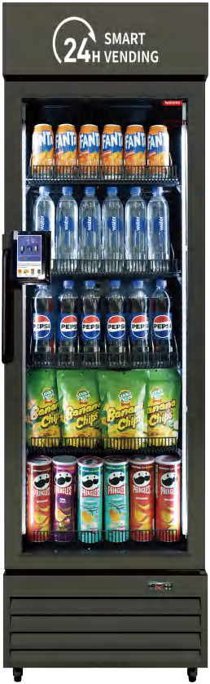


Parameter Details： Mini 360
Product Parameters
Exterior Dimensions（WxDxH） | 22.8*26*76 inch | Technology Implementation | AI Vision Technology
Product Weight | 189.6 lb | Communication Method | 4G
Product Capacity | 13.9 cu ft | Shelf Display | 6 shelves (5 shelves of 500ml bottled products + 1 shelves of 330ml canned products) ≈ 252 bottles of beverage
Power Consumption | 2.0kW·h/24h | Payment Methods | Credit/Debit Cards and Apple Pay, etc.
Power | 200W | Cabinet Shelves | Standard 5 layers, adjustable
Rated Voltage/Frequency | 110~120V/60Hz | Anti-Fog Heating Door | /
Temperature Range | 32℉-50℉ | Door Frame Material | Aluminum alloy, long-lasting, durable, and not easily deformed
Cooling Method | Pure Air Cooling
Recognition Indicators
Recognition Accuracy | 99% | Recognition Speed | About 60 seconds
Supported Product Categories | Beverages, Snacks, and All Categories | New Product Time | Under 6 hours
www.hahavending.com
Notes:
标红的数据需要进一步核实

Slide 2
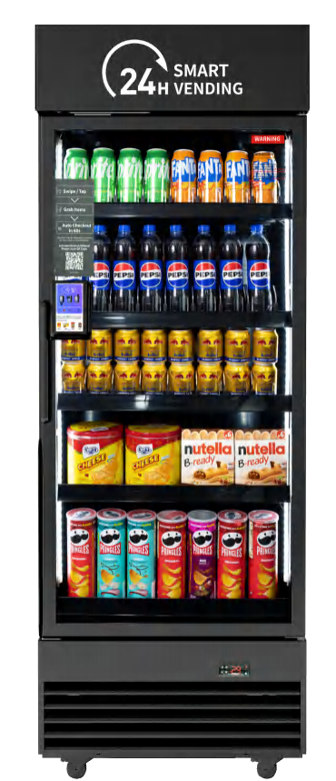
Parameter Details： Plus 440
Product Parameters
Exterior Dimensions（WxDxH） | 27.2*27*76.6 inch | Technology Implementation | AI Vision Technology
Product Weight | 232.6 lb | Communication Method | 4G
Product Capacity | 15.8 cu ft | Shelf Display | 6 shelves (5 shelves of 500ml bottled products + 1 shelves of 330ml canned products) ≈ 324 bottles of beverage
Power Consumption | 2.28kW·h/24h | Payment Methods | Credit/Debit Cards and Apple Pay, etc.
Power | 260W | Cabinet Shelves | Standard 5 layers, adjustable
Rated Voltage/Frequency | 110~120V/60Hz | Anti-Fog Heating Door | Standard, prevents product condensation
Temperature Range | 32℉-50℉ | Door Frame Material | Aluminum alloy, long-lasting, durable, and not easily deformed
Cooling Method | Pure Air Cooling
Recognition Indicators
Recognition Accuracy | 99% | Recognition Speed | About 60 seconds
Supported Product Categories | Beverages, Snacks, and All Categories | New Product Time | Under 6 hours
www.hahavending.com
Notes:
标红的数据需要进一步核实

Slide 3
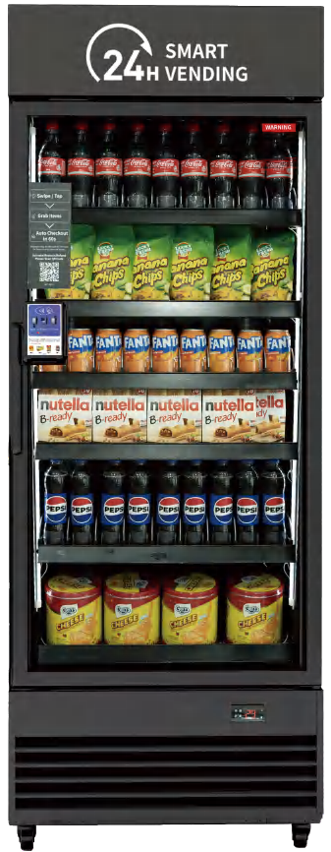
Parameter Details： Pro 542
Product Parameters
Exterior Dimensions（WxDxH） | 29.5*25.6*79.5 inch | Technology Implementation | AI Vision Technology
Product Weight | 270.1 lb | Communication Method | 4G
Product Capacity | 19.7 cu ft | Shelf Display | 6 shelves (5 shelves of 500ml bottled products + 1 shelves of 330ml canned products) ≈ 378 bottles of beverage
Power Consumption | 2.65kW·h/24h | Payment Methods | Credit/Debit Cards and Apple Pay, etc.
Power | 380W | Cabinet Shelves | Standard 6 layers, adjustable
Rated Voltage/Frequency | 110~120V/60Hz | Anti-Fog Heating Door | Standard, prevents product condensation
Temperature Range | 32℉-50℉ | Door Frame Material | Aluminum alloy, long-lasting, durable, and not easily deformed
Cooling Method | Pure Air Cooling
Recognition Indicators
Recognition Accuracy | 99% | Recognition Speed | About 60 seconds
Supported Product Categories | Beverages, Snacks, and All Categories | New Product Time | Under 6 hours
www.hahavending.com

Slide 4
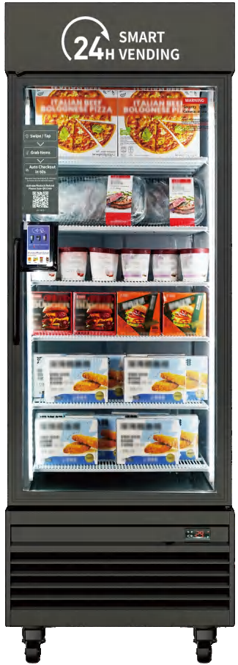
Parameter Details： Freezer 550
Product Parameters
Exterior Dimensions（WxDxH） | 27.6*35.8*80.4 inch | Technology Implementation | AI Vision Technology
Product Weight | 329.6 lb | Communication Method | 4G
Product Capacity | 20.0 cu ft | Shelf Display | 6 shelves (5 shelves of 500ml bottled products + 1 shelves of 330ml canned products) ≈ 384 bottles of beverage
Power Consumption | 8.33kW·h/24h | Payment Methods | Credit/Debit Cards and Apple Pay, etc.
Power | 500W | Cabinet Shelves | Standard 6 layers, adjustable
Rated Voltage/Frequency | 110~120V/60Hz | Anti-Fog Heating Door | Standard, Three-layer hollow electric heating
Temperature Range | (-8)℉~(-1)℉ | Door Frame Material | Aluminum alloy, long-lasting, durable, and not easily deformed
Cooling Method | Pure Air Cooling
Recognition Indicators
Recognition Accuracy | 99% | Recognition Speed | About 60 seconds
Supported Product Categories | Ice Cream, Frozen Desserts, Frozen Prepared Foods, and More | New Product Time | Under 6 hours
www.hahavending.com
Notes:
标红的数据需要进一步核实

Slide 5
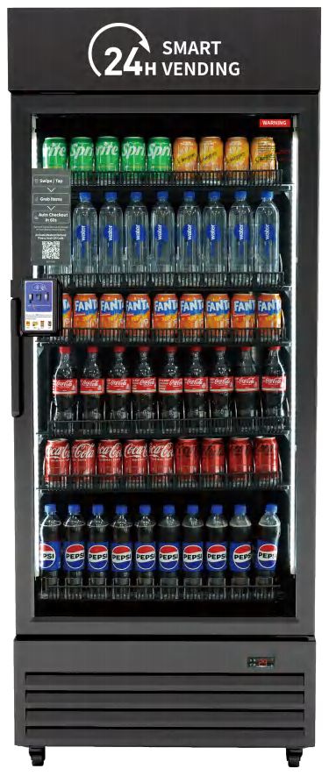
Parameter Details： Max 620
Product Parameters
Exterior Dimensions（WxDxH） | 31.5*26.4*79.5 inch | Technology Implementation | AI Vision Technology
Product Weight | 242.5 lb | Communication Method | 4G
Product Capacity | 20.9 cu ft | Shelf Display | 6 shelves (5 shelves of 500ml bottled products + 1 shelves of 330ml canned products) ≈ 420 bottles of beverage
Power Consumption | 4.2kW·h/24h | Payment Methods | Credit/Debit Cards and Apple Pay, etc.
Power | 360W | Cabinet Shelves | Standard 6 layers, adjustable
Rated Voltage/Frequency | 110~120V/60Hz | Anti-Fog Heating Door | Standard, prevents product condensation
Temperature Range | 32℉-50℉ | Door Frame Material | Aluminum alloy, long-lasting, durable, and not easily deformed
Cooling Method | Pure Air Cooling
Recognition Indicators
Recognition Accuracy | 99% | Recognition Speed | About 60 seconds
Supported Product Categories | Beverages, Snacks, and All Categories | New Product Time | Under 6 hours
www.hahavending.com

Slide 6
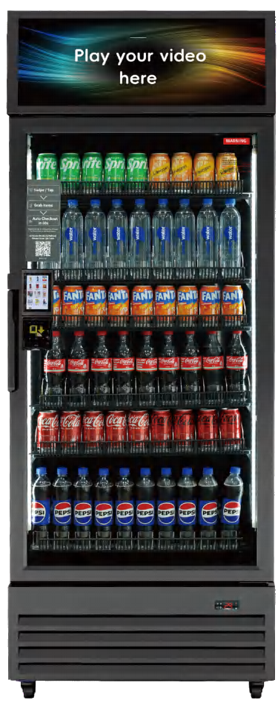
Parameter Details： Max 620S
Product Parameters
Exterior Dimensions（WxDxH） | 31.5*26.4*85.8 inch | Technology Implementation | AI Vision Technology
Product Weight | 242.5 lb | Communication Method | 4G
Product Capacity | 20.9 cu ft | Shelf Display | 6 shelves (5 shelves of 500ml bottled products + 1 shelves of 330ml canned products) ≈ 420 bottles of beverage
Power Consumption | 4.2kW·h/24h | Payment Methods | Credit/Debit Cards and Apple Pay, etc.
Power | 360W | Cabinet Shelves | Standard 6 layers, adjustable
Rated Voltage/Frequency | 110~120V/60Hz | Anti-Fog Heating Door | Standard, prevents product condensation
Temperature Range | 32℉-50℉ | Door Frame Material | Aluminum alloy, long-lasting, durable, and not easily deformed
Cooling Method | Pure Air Cooling
Recognition Indicators
Recognition Accuracy | 99% | Recognition Speed | About 60 seconds
Supported Product Categories | Beverages, Snacks, and All Categories | New Product Time | Under 6 hours
www.hahavending.com

Slide 7
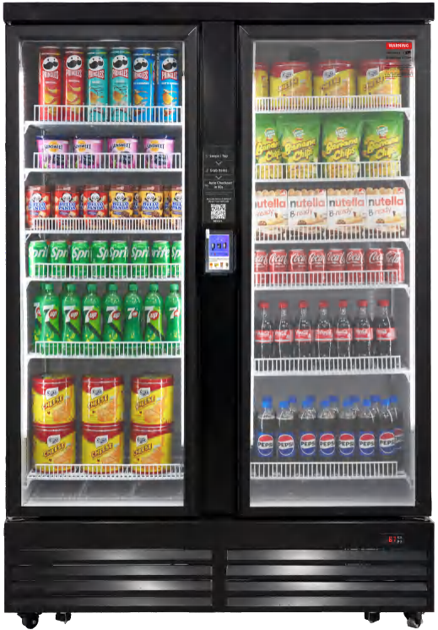
Parameter Details： Ultra 1200
Product Parameters
Exterior Dimensions（WxDxH） | 53.9*28.0*79.5 inch | Technology Implementation | AI Vision Technology
Product Weight | 379.2 lb | Communication Method | 4G
Product Capacity | 39.9 cu ft | Shelf Display | 12 shelves of 500ml bottled products ≈ 756 bottles of beverage
Power Consumption | 6.2kW·h/24h | Payment Methods | Credit/Debit Cards and Apple Pay, etc.
Power | 420W | Cabinet Shelves | Standard 6*2(12) layers, adjustable
Rated Voltage/Frequency | 110~120V/60Hz | Anti-Fog Heating Door | Standard, prevents product condensation
Temperature Range | 32℉-50℉ | Door Frame Material | Aluminum alloy, long-lasting, durable, and not easily deformed
Cooling Method | Pure Air Cooling
Recognition Indicators
Recognition Accuracy | 99% | Recognition Speed | About 60 seconds
Supported Product Categories | Beverages, Snacks, and All Categories | New Product Time | Under 6 hours
www.hahavending.com

